Slide 1



TOOLKIT
CASCADE TRAINING
SOUPHANOUVONG UNIVERSITY’S INTERNATIONALISATION STRATEGIC PLAN
SOUPHANOUVONG UNIVERSITY
1st DECEMBER 2021
By: Thongkham HUNGSAVATH
E-mail: thongkham.hsv@gmail.com
SOUPHANOUVONG UNIVERSITY

Slide 2

Vision and mission
Vision
To promote student, staff and researcher mobility
Mission
To improve language proficiency of students, staff, lecturers and researchers;
To develop international programmes;
To set up a good management system for mobility;
To develop university’s infrastructure, classrooms and dormitories.
SOUPHANOUVONG UNIVERSITY

Slide 3
SWOT Analysis
Strengths
Good cooperation with foreign institutions and organisations;
Opportunity in attracting funding to improve capacities of researchers and lecturers and exchange students (e.g. NGOs ERASMUS+ ADB…)
Weaknesses
No international courses;
No applications for international students to apply to go and study at the university;
Students’ limited language proficiency;
Language issues of lecturers and staffs;
No scholarships for international students
SOUPHANOUVONG UNIVERSITY

Slide 4
SWOT Analysis
Weaknesses (con)
Limitation of research capacity of researchers and lecturers;
Credit transfer and recognition issues;
Few outbound students due to limited budget;
No accommodation for exchange students, staff, lecturers and researchers;
Issues in disseminating university’s information on website, Facebook…..;
Young staff and lecturers with limited skills and experiences;
Issues of terms of reference of intern-departments;
Complication in cooperation between inter-departments;
SOUPHANOUVONG UNIVERSITY

Slide 5
SWOT Analysis
Opportunities
Ministry of Education and Sports has policy in supporting HEIs to cooperate with foreign institutions;
Good locations- world heritage city;
Human resource development projects supported by ADB, KOICA, EU and partner universities;
The Lao government has a policy in strengthening second language competency starting at the third grade of primary school;
A least-developed country.
SOUPHANOUVONG UNIVERSITY

Slide 6
Factors influencing the internationalisation strategy
Threats
MOEs does have not internationalisation strategies;
No guidelines for international students to apply for visas;
Issues of recognition of qualifications of students graduating for a Lao university of foreign universities;
A lack of comprehensive understanding on internationalisation of the Lao government.
SOUPHANOUVONG UNIVERSITY

Slide 7
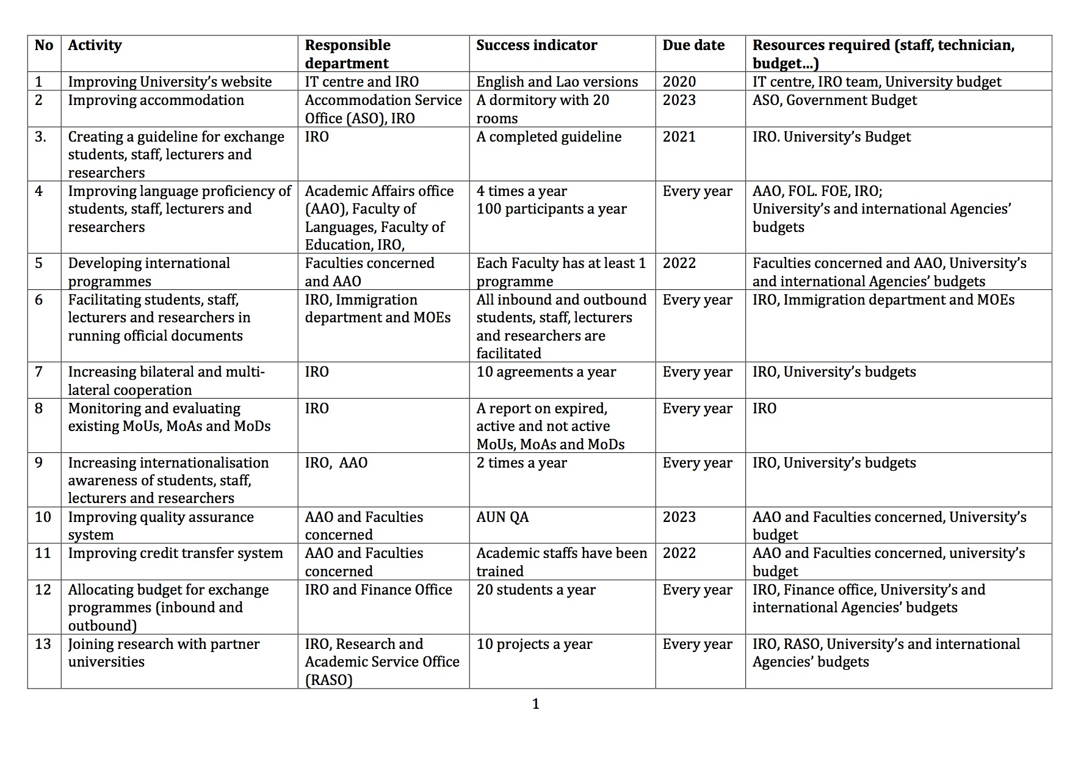
Action plan
SOUPHANOUVONG UNIVERSITY
SOUPHANOUVONG UNIVERSITY

Slide 8
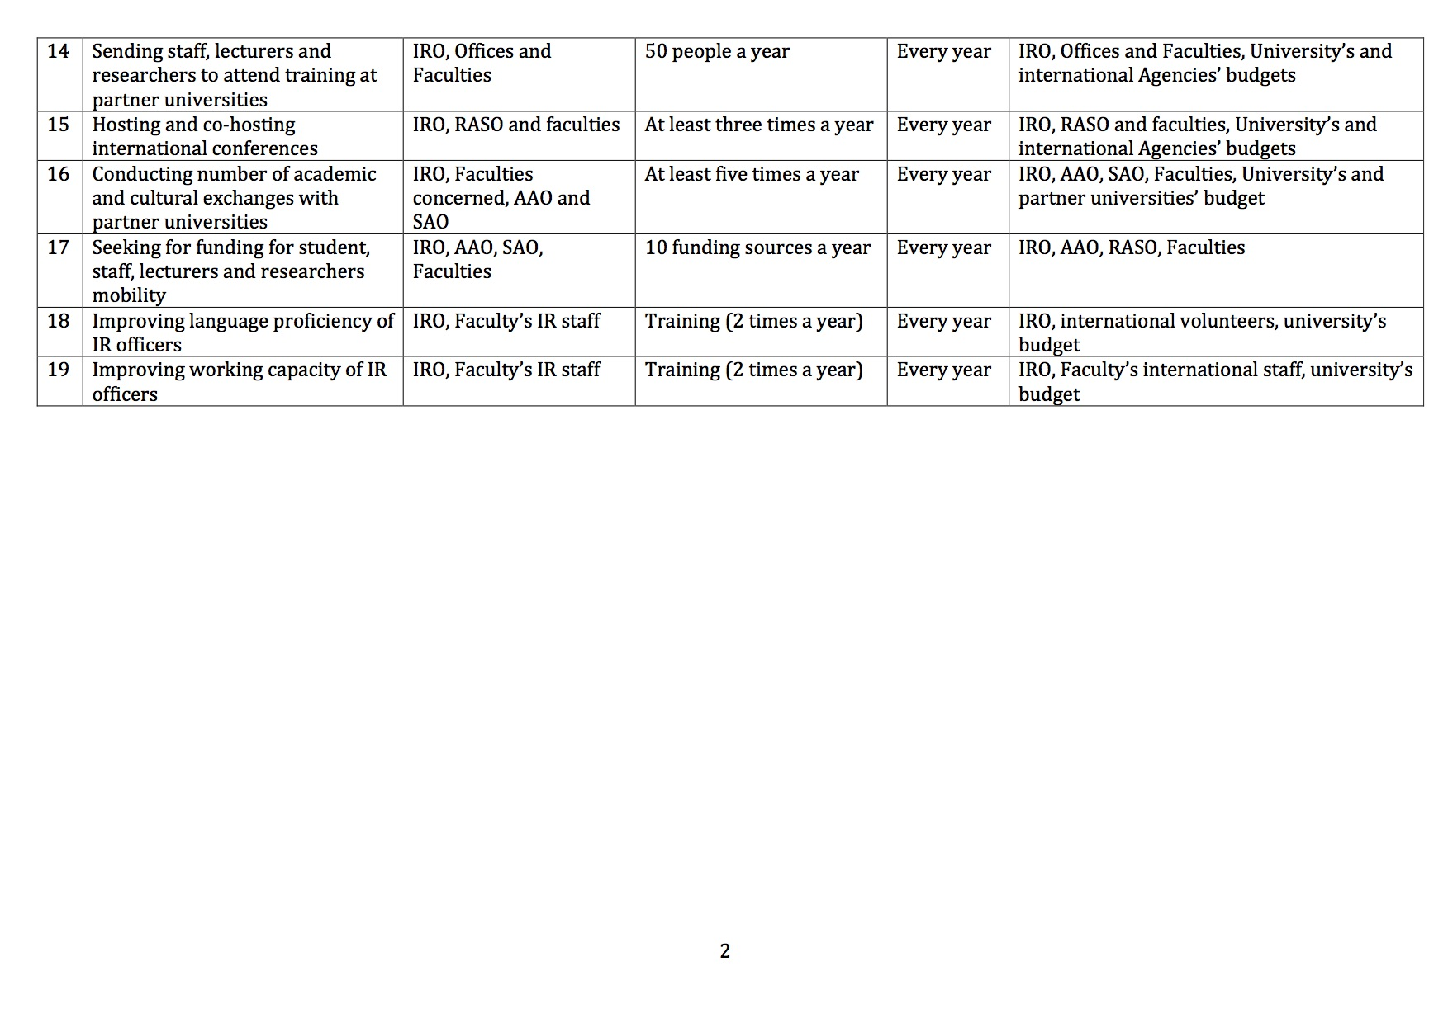
Goal
SOUPHANOUVONG UNIVERSITY
SOUPHANOUVONG UNIVERSITY

Slide 9
Souphanouvong University
Thank You for Your Attention
Any Questions?
SOUPHANOUVONG UNIVERSITY

